Slide 1

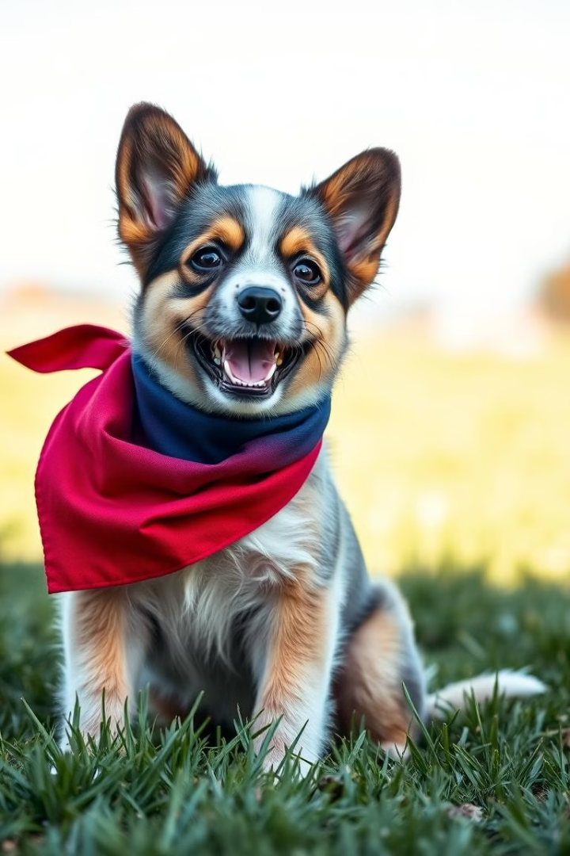
PET ADOPTION PLATFORM
Presented by :
231FA04462
231FA04613
231FA04F77
231FA04F81 :
Notes:
1

Slide 2
Introduction:
A pet adoption platform is an online service designed to connect homeless animals with potential adopters. It serves as a bridge between animal shelters, rescue organizations, and individuals looking to adopt pets. These platforms provide a user-friendly interface where adopters can browse available pets, filter by species, breed, age, and location, and learn about each pet’s history, medical condition, and personality traits.
Our platform also offer additional features like adoption guides, and integration with veterinary services with collaborated NGO’s to ensure a smooth transition for both the pet and the adopter. By leveraging technology, these platforms help reduce the number of animals in shelters and promote responsible pet ownership, ultimately creating loving homes for pets in need.

Slide 3


About Our Project
Variety of pets
1
Adopt dogs, cats, and birds from local shelters.
Search and filters
2
Allow users to filter pets by type, breed, size, age,
and location.
3
Adoption Process
Enable users to submit adoption applications and track their status..
Resources
4
Provide articles on pet care, training, and responsible ownership.
Notes:
2

Slide 4

Available Pets
Dogs
Birds
Parrots, finches, and more, ready to
bring joy to your home.
Various breeds and sizes to choose from.
1
2
3
4
Cats
Health checks
Domestic and exotic breeds for
all personalities.
All pets are vaccinated and health-checked for your peace of mind.
Notes:
3

Slide 5
Login and User Accounts
Secure login
Keep your information safe with our secure
login system.
User profiles
Track your adoption history and favorite pets.
Filter by type
Filter pets by type (e.g. cats, dogs)
Notifications
Get updates on pet availability and adoption
process through mail.
Notes:
4

Slide 6
Adoption Process
Create an account
Sign up for free to start your adoption journey.
Choose a pet
Browse our website and find your perfect match based on your choice and requirements.
Complete application
Fill out our simple adoption application form.
Finalize adoption
If you decide to keep the pet, finalize the adoption.
Notes:
5

Slide 7
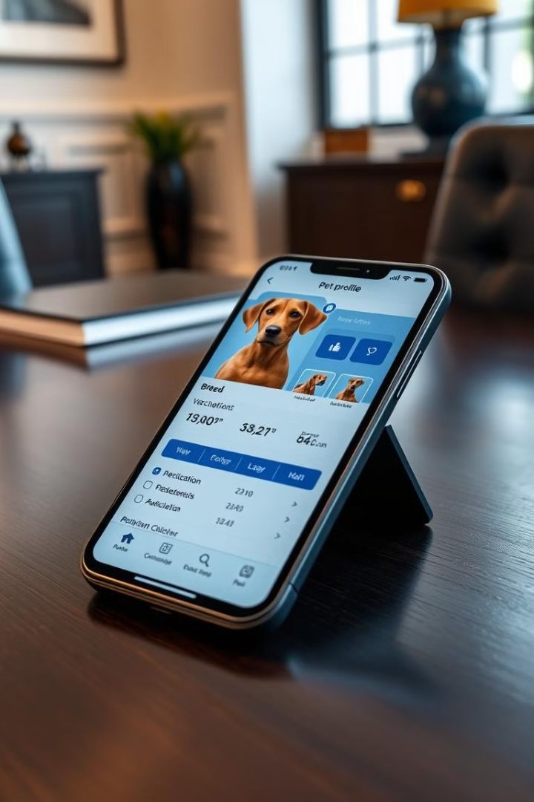




User-Friendly Features
Search filters
Photo gallery
Pet profiles
Find pets by type, age, and size.
See photos of each pet to find your perfect match.
Detailed information about each pet's health and personality.
Real-time updates
See which pets are available and ready for adoption.
Notes:
6

Slide 8
Existing platforms
Simply they focus on listed pets available for adoption and let users to apply.
They mainly focus on basic searches and payment based..
Our project
.
Our project mainly focuses on payment free .
Providing shelter to street animals.
Before giving the pet to customers we will check the health condition of the pets with collaborated NGO’s.

Slide 9

Benefits of Adoption
1
2
Find your companion
Save a life
Give a deserving pet a loving home.
Discover the perfect pet for your personality
and lifestyle.
3
4
Support shelters
Affordable option
Help local animal shelters by giving pets a
second chance.
Adopt a pet at free of cost .
Notes:
8

Slide 10
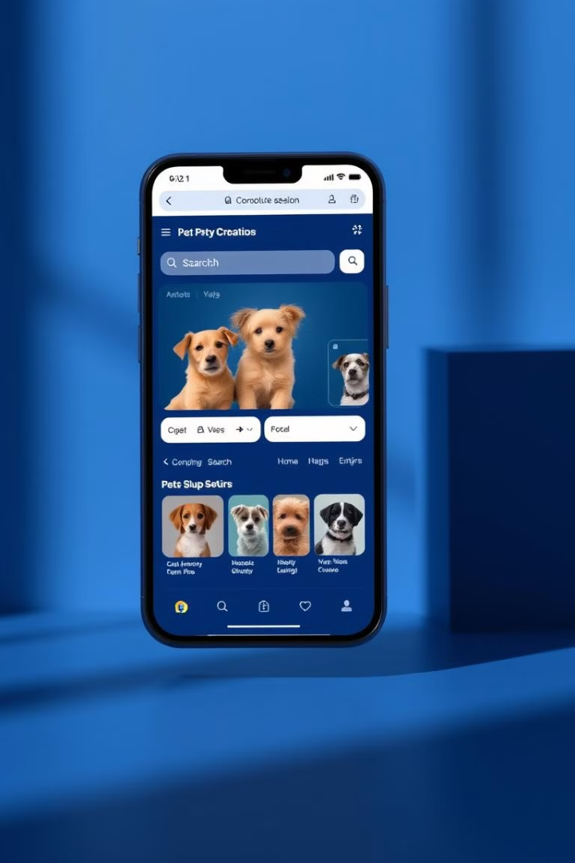




How It Works
Pet Listings
Each listing includes photos, breed, age, health status .
User Registration
People looking to adopt create an account.
Adoption Application
Users submit an application for the pet they want
to adopt.
Adoption Finalization
Once approved, the adopter completes the paperwork
Digitally.
Adoption completed
Notes:
9

Slide 11
Our Web Application
Frontend
HTML, CSS, JavaScript to create login page and home page
Database
MongoDB stores pet and user data securely.
Backend
Powered by Node.js and Xampp for robust functionality.
Languages
HTML, CSS, and JavaScript for a user-friendly interface.
Notes:
10

Slide 12
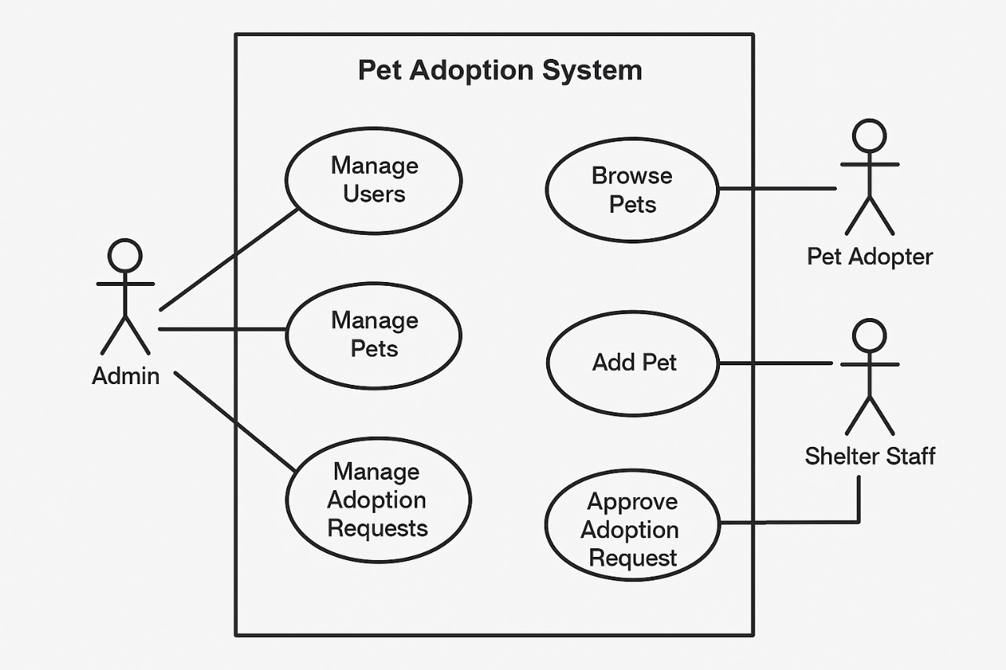
Use case diagram

Slide 13
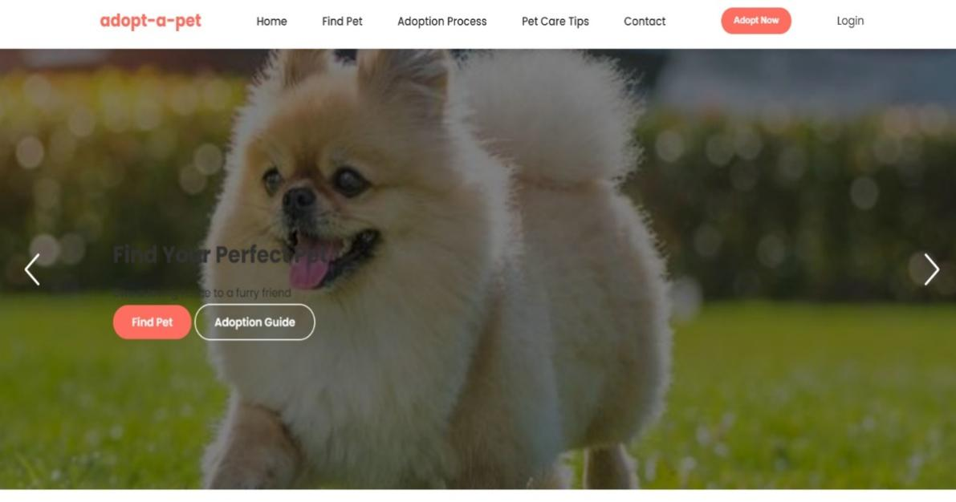
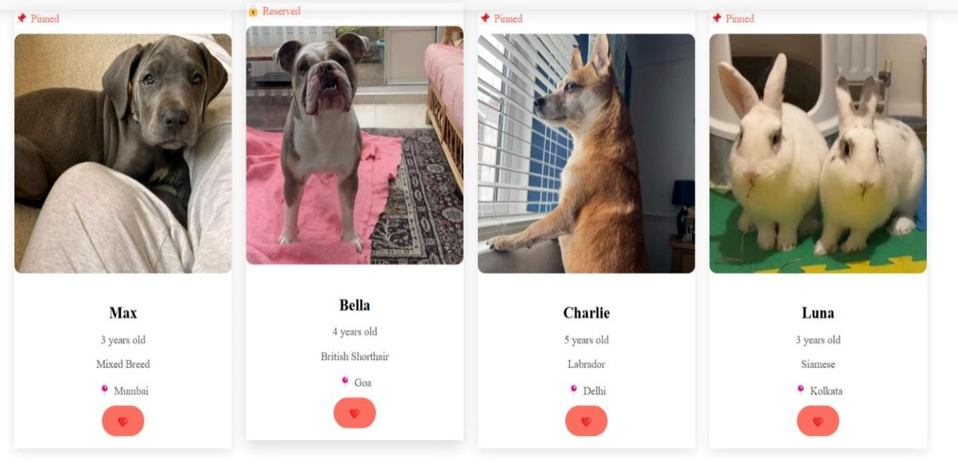
Output

Slide 14
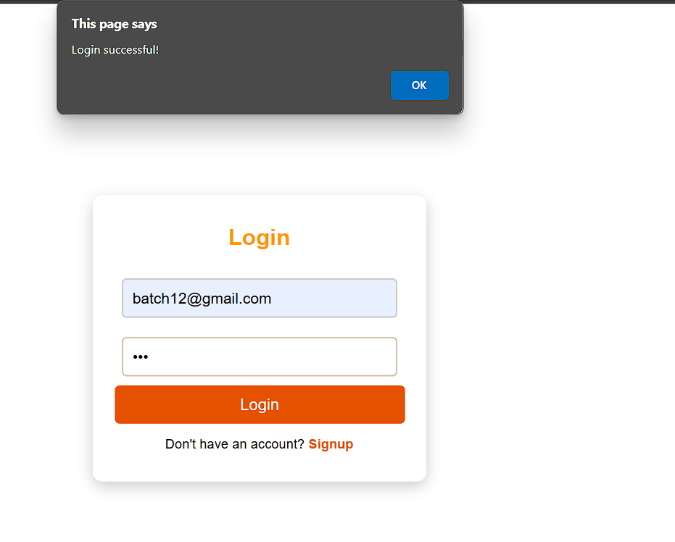
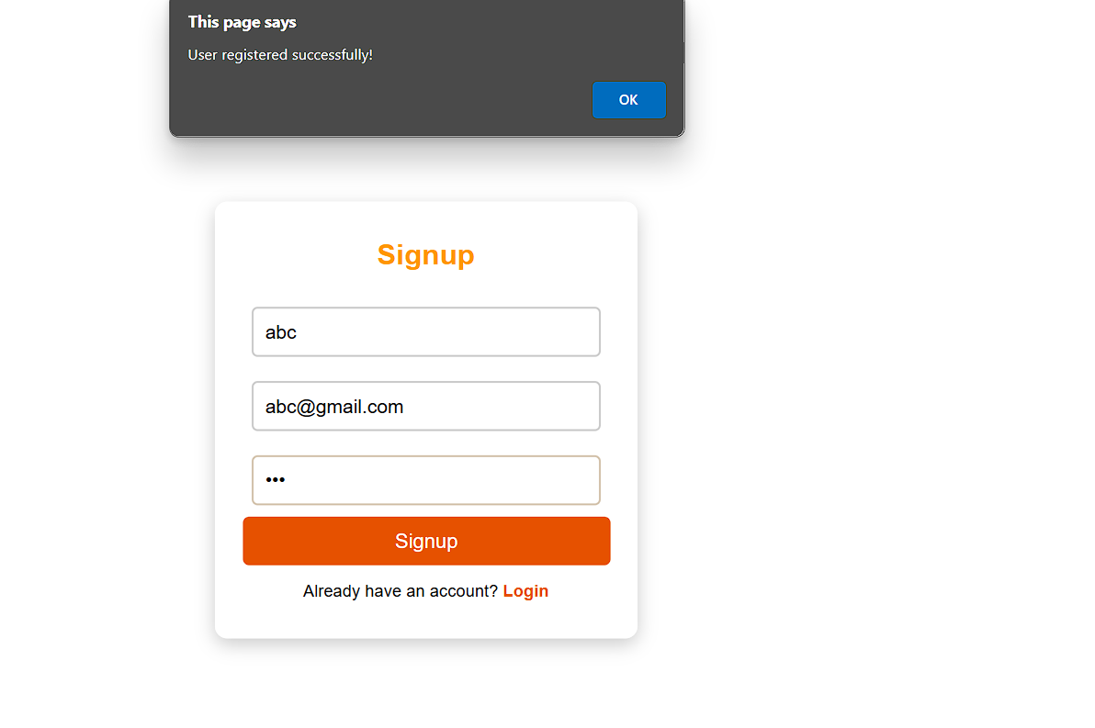

Slide 15
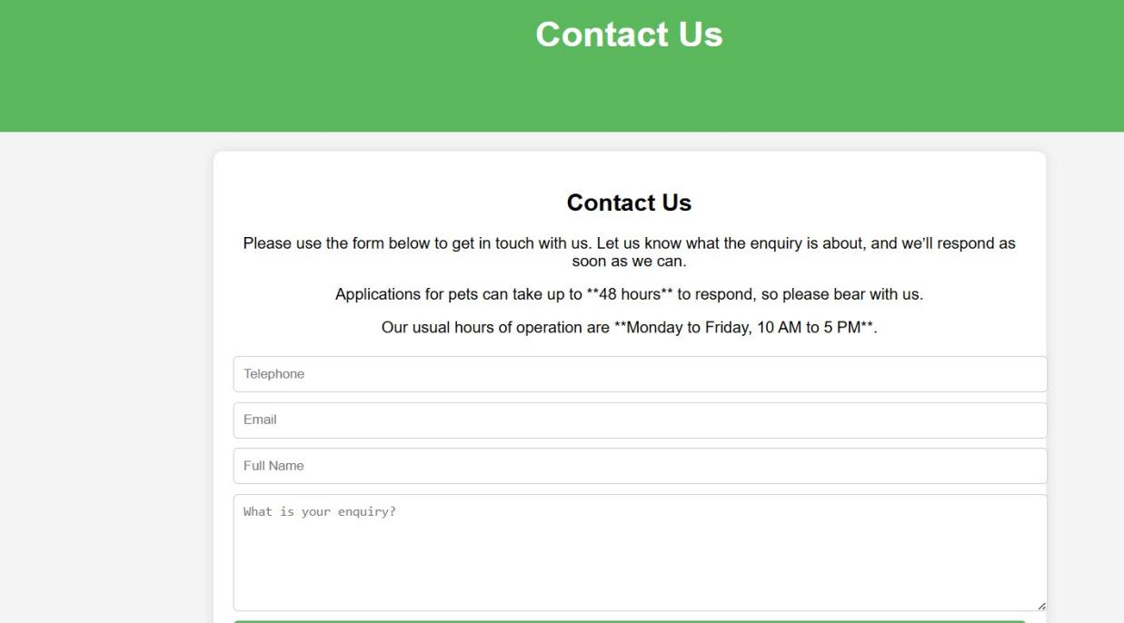
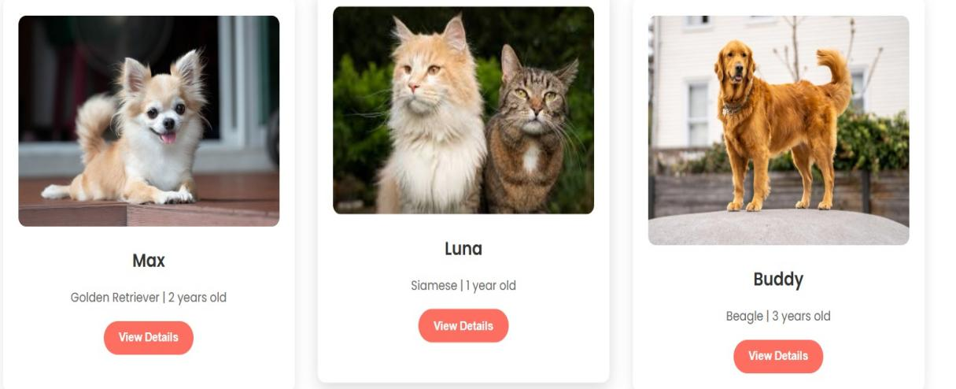

Slide 16
References
1. https://thepetnest.com/adopt-a-pet
2. http://petfinder.com/
Based on these references we took this project.
And we have some other enhancements differ from these
projects in future.

Slide 17
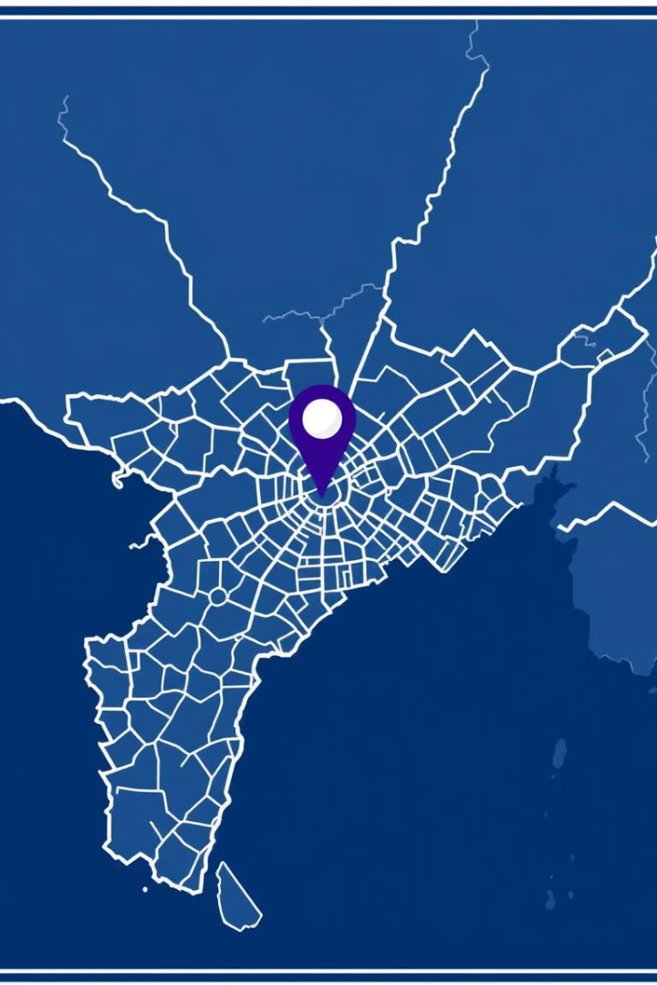
Contact Us
Visit our website, email us, Message through Instagram , Facebook.
Github-Link:
https://venkat666d.github.io/pet-adaption1/
Notes:
11

Slide 18
Thank you

